Slide 1
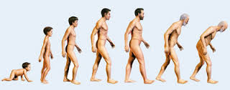
ObGyn Watch
Some thoughts on Ageing
Narayanan R
Notes:
Ageing is unique to man because animals in natural surroundings die before they age due to predation, disease or starvation.

Slide 2
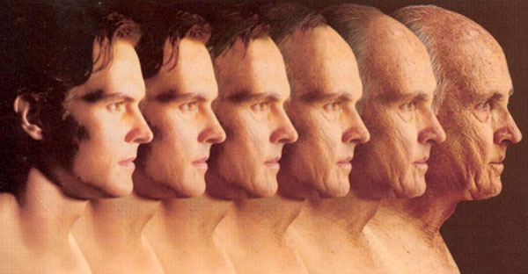
What is Ageing?
“Gradual deterioration in cells leading to disease and death”

Slide 3
“Life expectancy is the average age humans expect to live”
Unchanged for 1,00,000 years
In the past century, more years have been added to life than all previous millennia
Because, our ability to respond to stress and disease is changing
‘Technophysio-evolution’

Slide 4
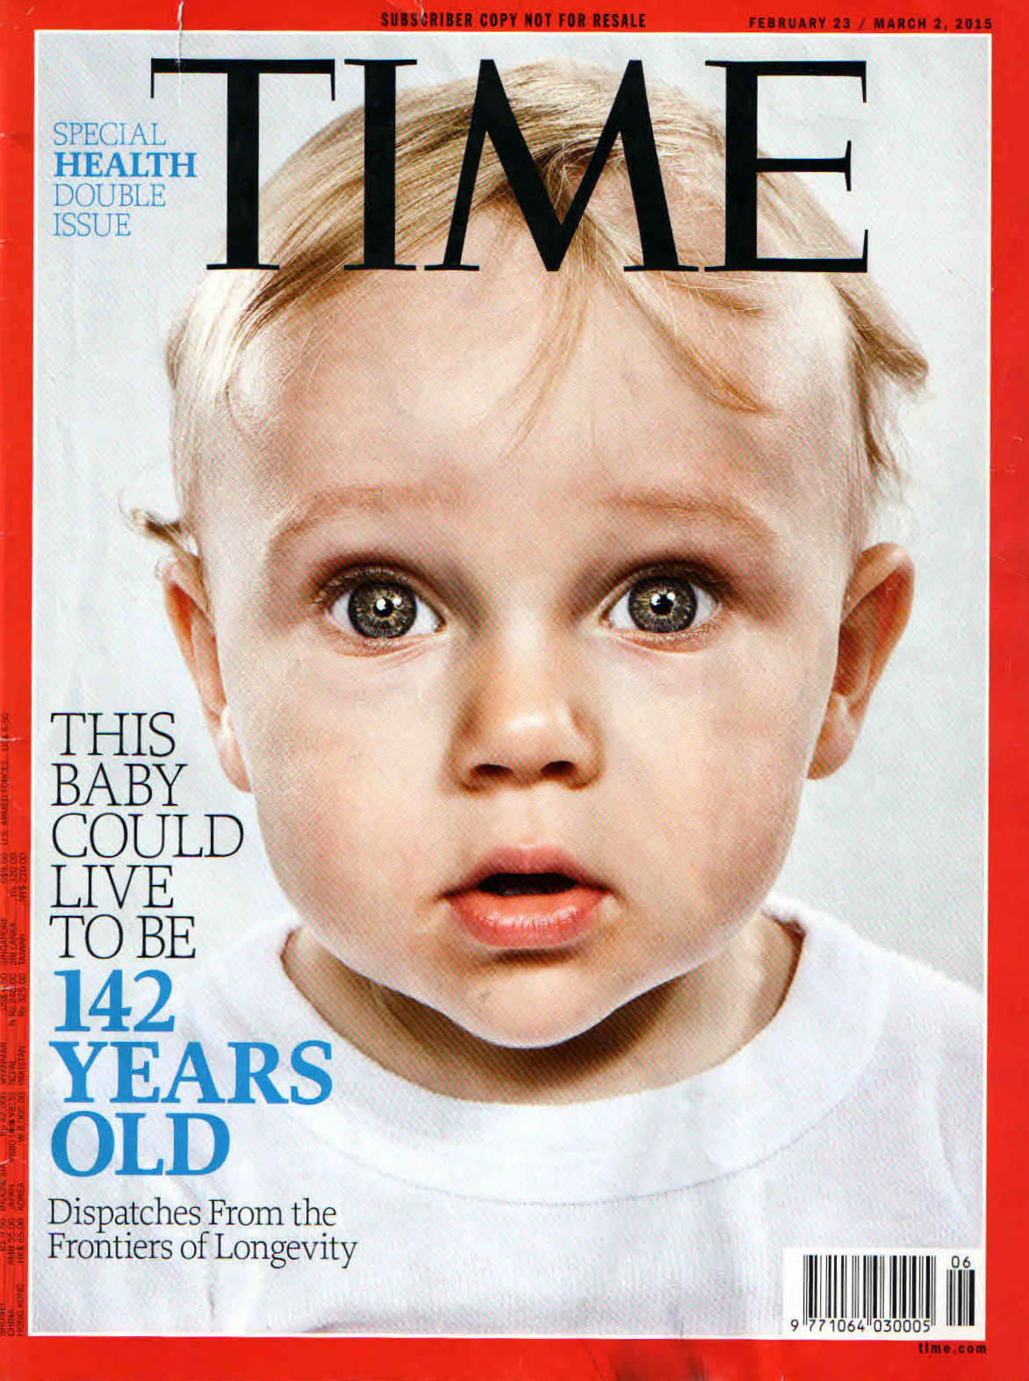

Slide 5
Theories of Ageing
Evolutional-Haldane 1941
Telomere-Hayflick 1965
Gene regulation-Kanungo 1975
Mitochondrial-Cadenas 2000
Immune-Franceschi 2000
Cellular senescence-Hayflick 2000
Inflammation-Chung 2001
Free Radical-Harman 2003

Slide 6
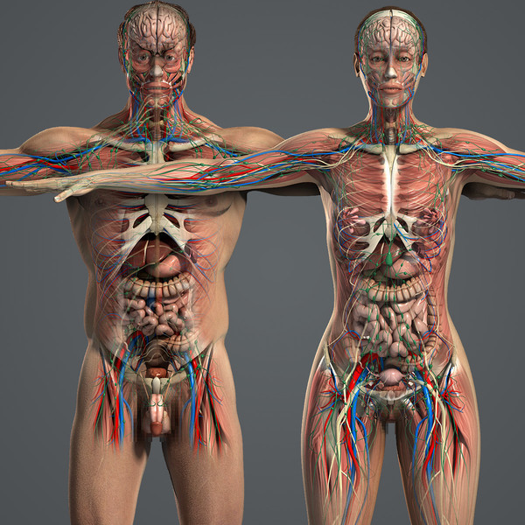
Timeline for Ageing
70
40
BRAIN
EYES
60
40
EARS
MUSCLES
65
30
HEART
LUNGS
50
KIDNEY
18
SKIN
60
GUT
BONES
35

Slide 7

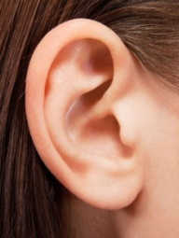
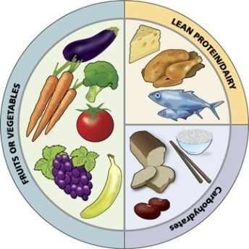
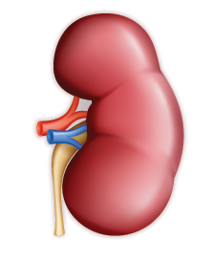

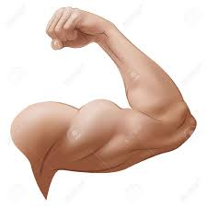

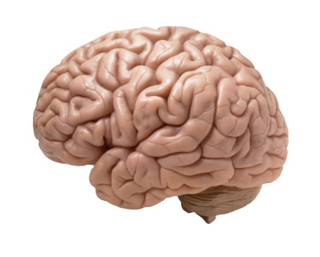
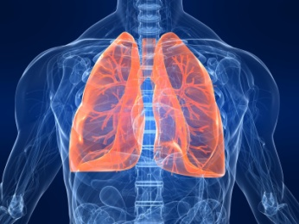
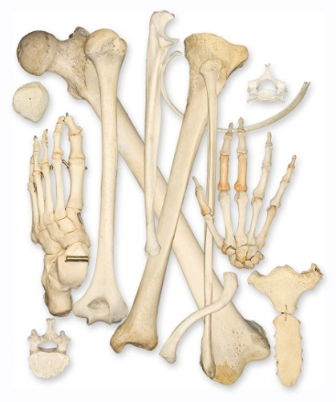
Remedies?
Avoid UV
Avoid noise
Nutrition
Increase
Water intake
Sun screen
Exercise
No smoking
Activity
Breathing exercise

Slide 8
Life style Modifications
Plant-based Diet
Stress Management
Meditation
Yoga
Breathing exercise
Moderate exercise
Social support
Eat less
Move more
Stress less
Love more

Slide 9
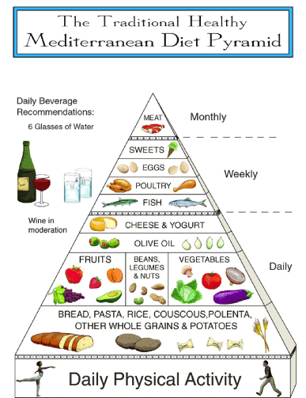

Slide 10
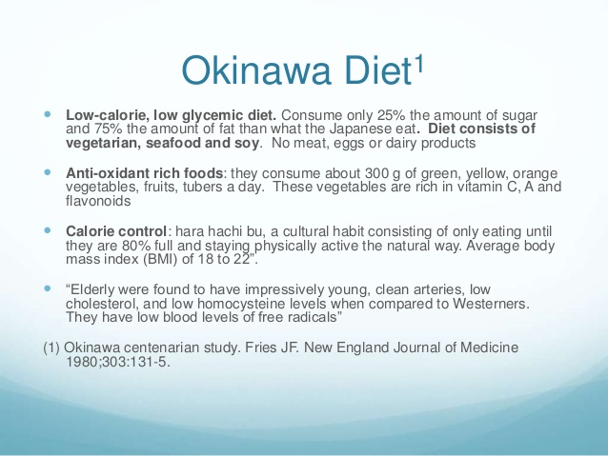
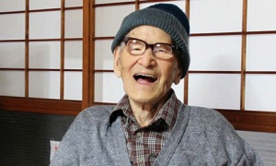
Jiroemon Kimura, from Kyoto, lived to be the world's oldest man on record at 116.

Slide 11
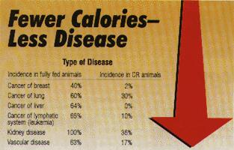
Calorie Restriction (CR)

Slide 12
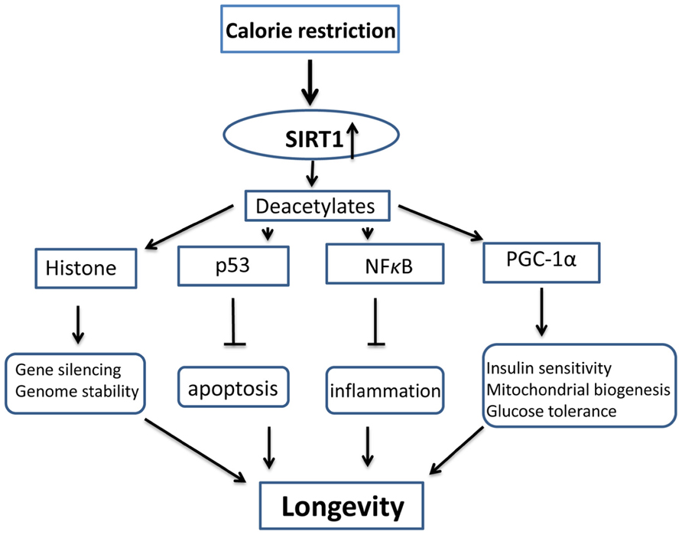
Calorie Restriction (CR)
CR by 20% increases longevity & decreases age-related diseases in several species
Mechanism not known
Alters metabolic programming by decreasing BMI & Oxidative stress

Slide 13
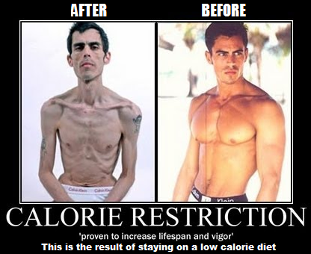

Slide 14
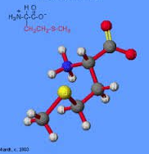
Methionine deprivation:
Life span
Hormones to protect Heart
Fights obesity
Energy
Insulin sensitivity
Eliminates CA cells
Notes:
Amino acid plays role on Protein synthesis/CR acts the same manner.

Slide 15
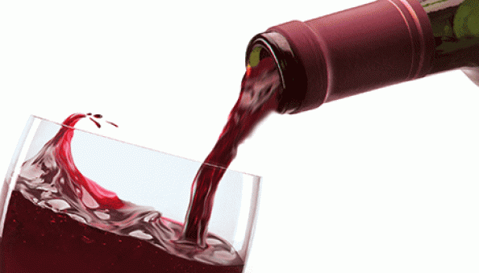
Age Interruptors
Low incidence of Heart Disease in France
RESERVATOL in Red Wine is touted as Fountain of Youth
Found in Grape skin, Japanese Knot weed & Peanuts
Contains powerful anti Oxidants

Slide 16
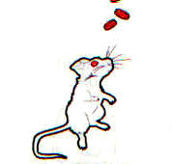
Rapamycin
Antibiotic from soil sample in Easter island 1964
Acts on variety of species
Interrupts function of gene mTOR which directs cell intake of energy in mouse & man
Works the same way as calorie restriction
Mouse UT2598
holds the record for longevity
- University of Texas Health science

Slide 17
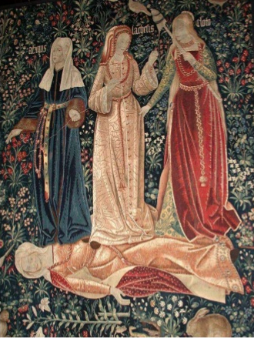
Klotho
A protein regulating gene discovered by Kuroo et al in 1997
Named the “Klotho gene” after the Greek mythological goddess who spins the thread of life

Slide 18
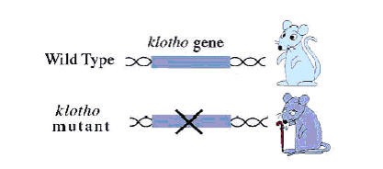
Klotho gene
Mice with klotho gene live 30% longer
1 in 5 humans carry the gene
Gene therapy or cell transplants
may help those who lack the gene

Slide 19
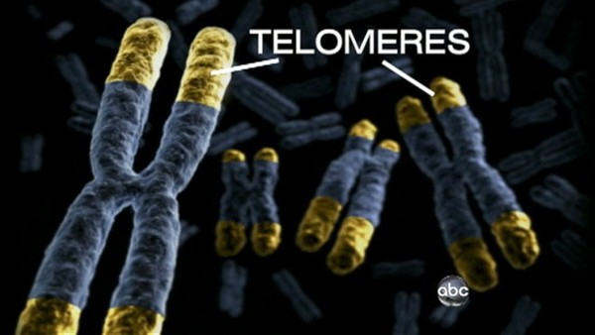
23 pairs of chromosomes carry our DNA
They have protective caps called Telomeres
When cell divides, telomere shortens &the cell dies
Telomerase controls this process
Telomerase switched off in humans as cells age
Notes:
23 pairs of chromo carry our DNA-Protective cap called Telomeres-When cell divides telomere shortens, cell dies-Telomerase controls the process-
-Telomerase switched off in humans as cells age-Admn of T can lengthen telomeres

Slide 20
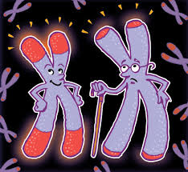
Telomerase
In Genetically manipulated mouse which lacks Telomerase Premature ageing sets in
Injection Telomerase reverses ageing in mouse
Notes:
Time keepers of cells life

Slide 21
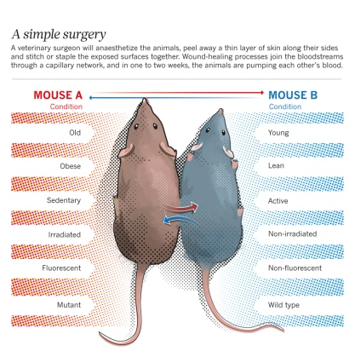
Parabiosis
Surgically conjoined mice
Interchange of blood between old & young mice
Young blood rejuvenates old mouse
Hormones & protein GDF11 responsible
Notes:
Younger blood rejuvenates older mouse. Protein GDF11 abundant in young animals.

Slide 22

Dracula Therapy
Platelet-Rich Plasma Therapy (PRP)
Using one’s own blood to rejuvenate
Spiked with aminoacids & vitamins
Repairs DNA-Heals bones, gums & scars-Revitalises skin

Slide 23
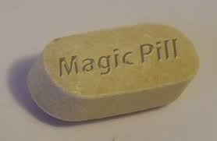
Mimetics
Calorie Restriction Mimetics (CRM) gives benefits of CR without dieting: Artemesinin-Metformin-Leptin-Oxaloacetate
Exercise Mimetics
Sleep Mimetics
Sex Mimetics

Slide 24
Ageing & Reproduction
Inextricably linked
Evolution aims at Survival
Reproduction ensures survival
Progeny takes over when one dies
Why reproduce when one can survive?
Sex organs will be downgraded

Slide 25
Childless Ageless Generation
Sperm count has fallen from 71mil to 52 mil in2011
sperm concentration falls by 2%/Year
Quality by 38% in 10 years
Testicular Ca: 2.4%
Cryptorchidism 2 to 8%
Hypospadias/Ov Ca/Br Ca
The ‘r-k’ Model:
R: risk to life = shorter life span = reproduction
K: Safe stable environment= fertility

Slide 26
Marriage & Longevity
Marriage is a big factor in survivorship!
Married people live longer, especially the Men!
The ‘Never married’ are twice as likely to die early!
Divorced women live longer (No husband burden!)
‘Broken heart syndrome’ (Dying soon after spouses death) is attributed to stress induced cardiomegaly
-Source: Life cycle study (1500-1921)

Slide 27
